Slide 1
Modeling Extreme Events in Time Series Prediction
Norwegian University of Science and Technology
Ding, Zhang, Pan, Yang, He (2019)

Slide 2
Motivation
Time series prediction is increasingly employed in safety-critical real-world scenarios, e.g. climate prediction and price forecasting
Extreme events have big impact in these systems, e.g. a natural disaster or a financial crisis
Accurately predicting these extreme events is of great value

Slide 3
Problem overview
Current DNN-models have difficulties learning patterns of extreme events (data imbalances)
i.e. 99% of data is normal, 1% are extreme events -> difficult to capture
Two common problems:
The model does not capture extreme events (underfitting)
The model captures extreme events, but generalizes poorly (overfitting)
Notes:
The current deep neural network models with the best results are the LSTM (Long Short-Term Memory) and the GRU (Gated Recurrent Unit)

Slide 4
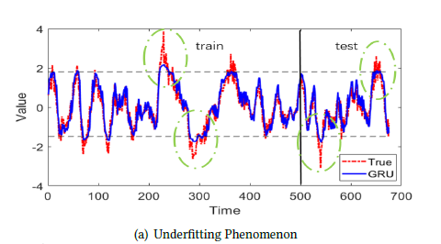
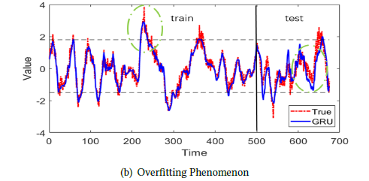
Problem overview
Doesn’t capture extreme events
Captures extreme event…
…but doesn’t generalize

Slide 5
Problem analysis
DNN-model that learns from square loss is in essence a Kernel Density Estimator (KDE) with Gaussian Kernel
Over- and underfitting problems are mainly due to lack of sufficient prior distribution on the tail part of observations

Slide 6
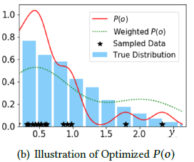
KDE
Few extreme-event samples leads to underfitting
Attempting to weight extreme events lead to overfitting
Notes:
Underfitting: overestimates probability of normal events (0 - 1.5), underestimates probability of extreme events (1.5 and above)
Overfitting: underestimates probability of normal events, more likely to have extreme events

Slide 7
Related work
Recently RNNs have shown great performance
LSTM and GRU have shown improvements upon standard RNN
Data imbalances have shown to cause two major problems in DNNs:
Lacks ability to model rarely occurring samples
Poor generalization
Previous studies have attempted to model the distribution of extreme values

Slide 8
Proposed solution
The goal is to impose a prior on the tail part of the distribution
Done by memorizing extreme events and modeling tail distribution
Memory network module is proposed
Extreme Value Loss (EVL) is proposed

Slide 9
Memory Network Module
Goal: memorize characteristics of extreme events
At each timestep:
Randomly sample M windows of ∆ sequential time-steps
Put the window through GRU, store last hidden state as latent space representation in vector S
Store whether there is an extreme event after the window in vector Q

Slide 10
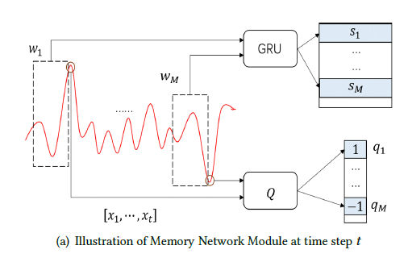

Memory Network Module
Window of Δ timesteps
Latent space representation
Extreme event indicator
Notes:
Extreme event indicator: +1 if above some threshold, -1 if below some threshold, 0 if between. +1 indicates right extreme event, 0 indicates normal event, -1 indicates left extreme event

Slide 11
Attention mechanism
For each timestep, calculate similarities to memorized events
Use similarities to predict whether next timestep is extreme event
Use prediction of extreme event to amplify output

Slide 12
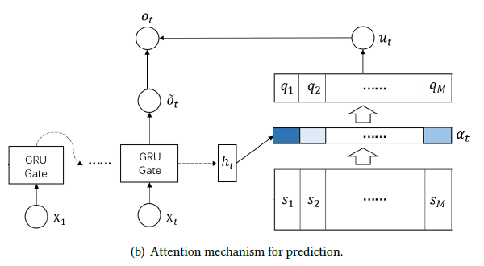

Attention mechanism
Prediction of extreme event
Amplifying part
Similarity to memory (attentive weights)

Slide 13

Advantage
Flexible switch between normal and extreme values
Similarity between current step and extreme event in history will set $u_{t}$ non-vanishing
Otherwise the system depends mostly on GRU output ${\tilde{o}}_{t}$

Slide 14
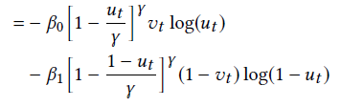
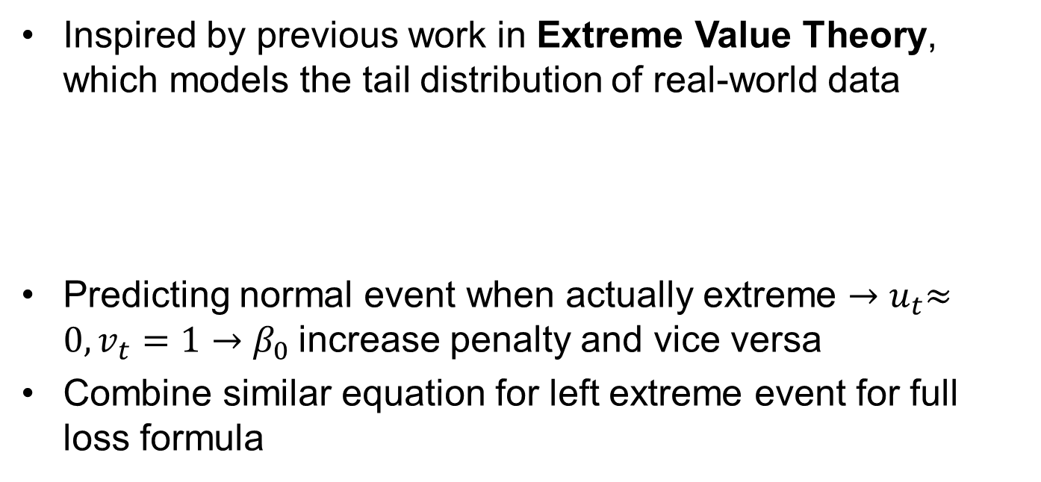
Extreme Value Loss
Inspired by previous work in Extreme Value Theory, which models the tail distribution of real-world data
Predicting normal event when actually extreme ${→u}_{t}≈0, v_{t}=1→β_{0}$increase penalty and vice versa
Combine similar equation for left extreme event for full loss formula
$$β_{0}:proportion of normal events (v_{t}=0)$$
$$β_{1}:proportion of right extreme events (v_{t}=1)$$

Slide 15


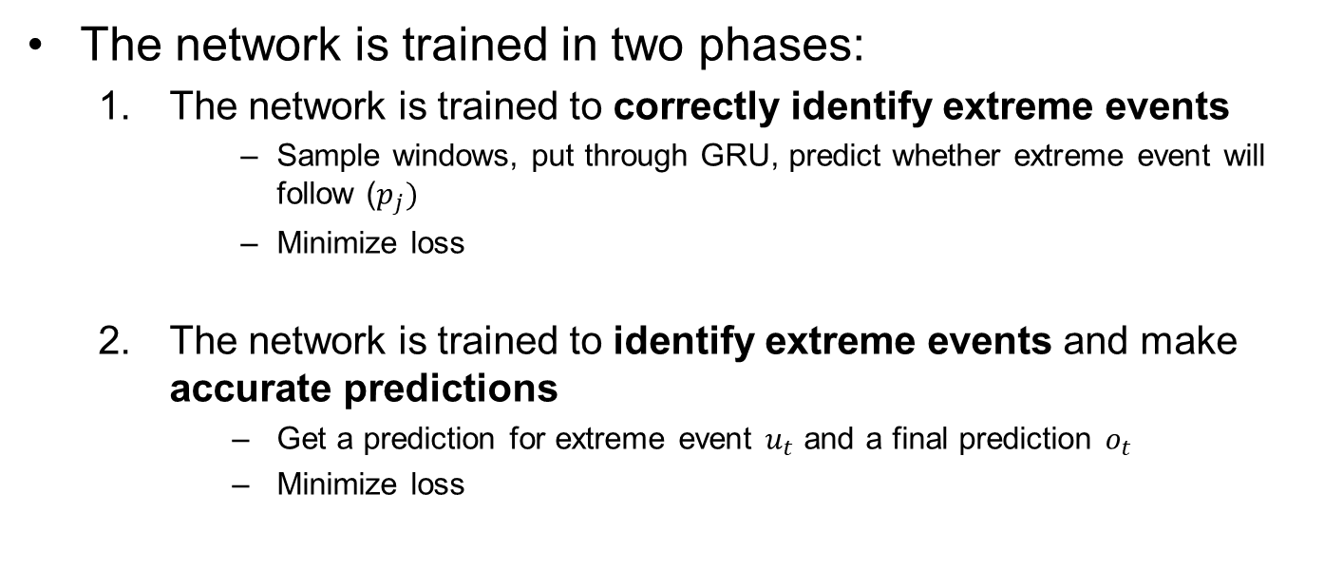
Training the network
The network is trained in two phases:
The network is trained to correctly identify extreme events
Sample windows, put through GRU, predict whether extreme event will follow ($p_{j})$
Minimize loss
The network is trained to identify extreme events and make accurate predictions
Get a prediction for extreme event $u_{t}$ and a final prediction $o_{t}$
Minimize loss

Slide 16
Experimental setting
Experiment was conducted on three types of data
Stock data: 564 corporations on NASDAQ between 2003-2017
Climate data: greenhous gases and CO2 concentration from the US
Synthetic data
Data was differenced
RMSE used as error metric

Slide 17
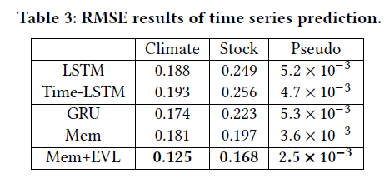
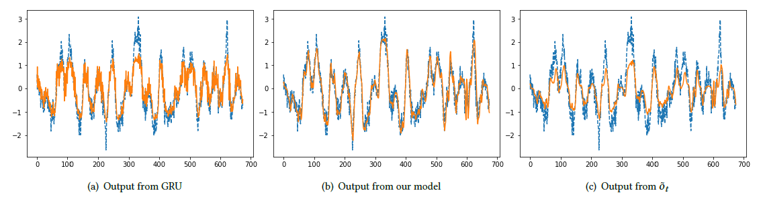
Results
The memory network using Extreme Value Loss scored better than baselines on all datasets

Slide 18
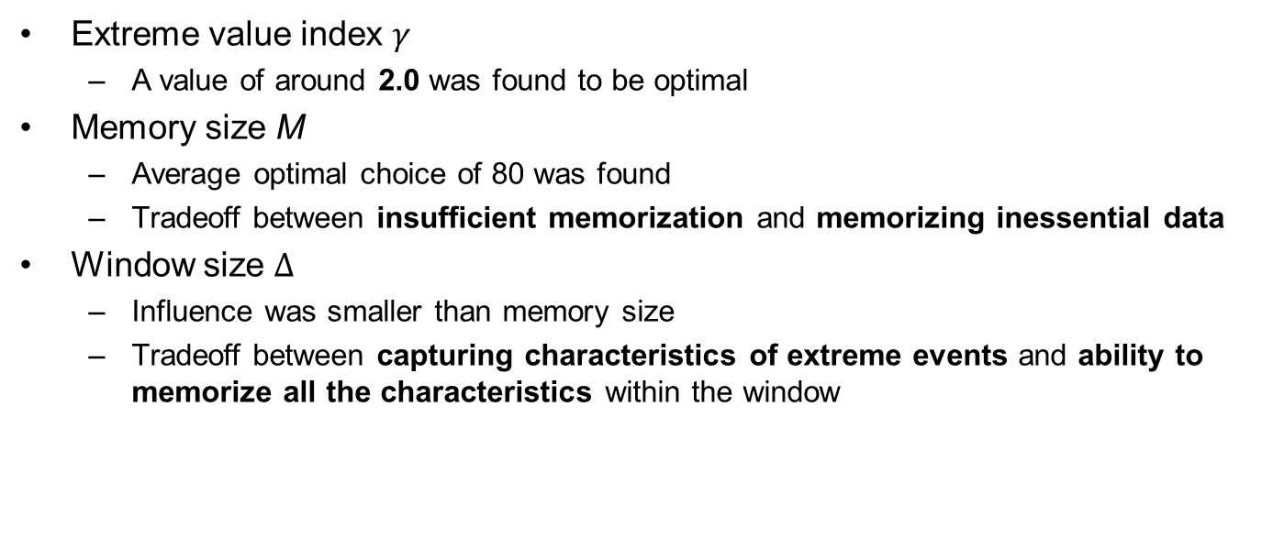
Hyperparameters
Extreme value index $γ$
A value of around 2.0 was found to be optimal
Memory size M
Average optimal choice of 80 was found
Tradeoff between insufficient memorization and memorizing inessential data
Window size $Δ$
Influence was smaller than memory size
Tradeoff between capturing characteristics of extreme events and ability to memorize all the characteristics within the window

Slide 19
Conclusions
Without prior knowledge on tailed observations, DNN-models are innately weak in capturing characteristics of extreme events
Two techniques were used to impose tailed priors
Memorizing extreme events in historical data (Memory Network)
Modeling the tail distribution (EVL loss)
The combined techniques showed superior perfomance compared with state-of-the-art models
Future research will focus on extending the framework to multi-dimensional time-series and its application in other tasks with data imbalances

